Slide 1
Working with CSV and EXCEL
Chandan Sharma

Slide 2
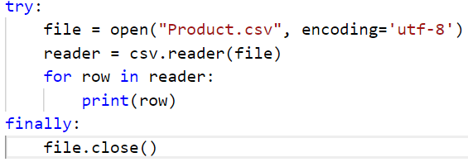
Working with CSV files:
CSV files can be thought as a database containing some records.
We design mechanism to read data stored in CSV file using Python.
The code of the right can be used to read data stored in a CSV file named as Product.csv.
We use the import csv package.

Slide 3
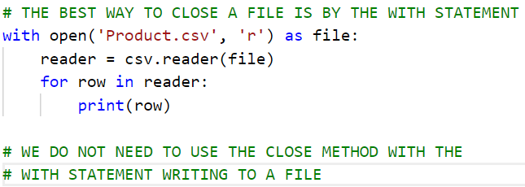
Working with CSV files:
The best way to open a csv file in Python is to use the with keyword in python
The main advantage of this approach is that we do not need to worry about closing the file.

Slide 4
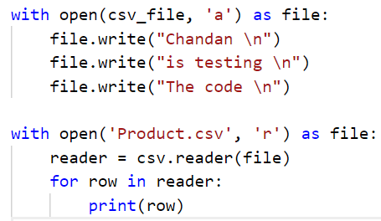
Working with CSV files:
We can write to multiple lines in a csv file by using the presented code.
We can use the special character \n which is used to insert into the next line.

Slide 5
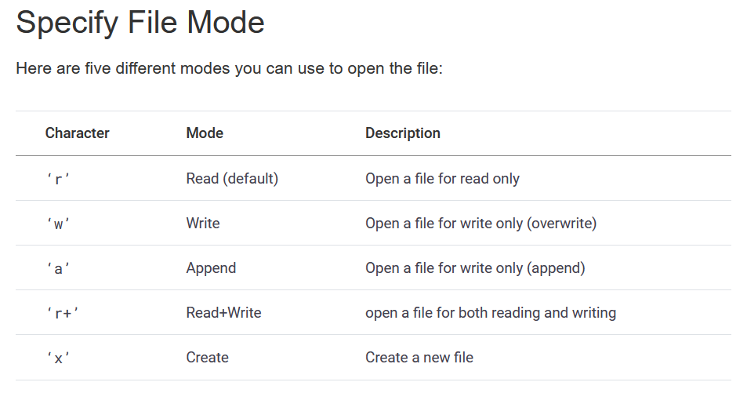

Slide 6
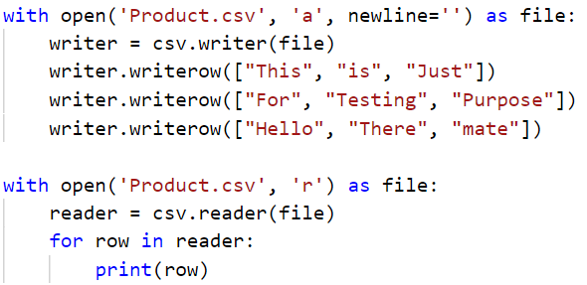
Working with CSV files:
We can also assign values to multiple rows by using the writerow() method.
This method intakes a list as an argument.

Slide 7
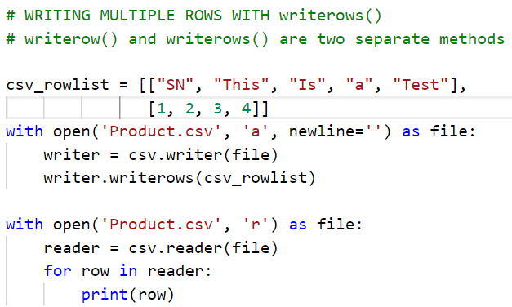
Working with CSV files:
The writerows() method can be used to insert multiple rows in a csv file
This method takes a list of list as an argument.

Slide 8
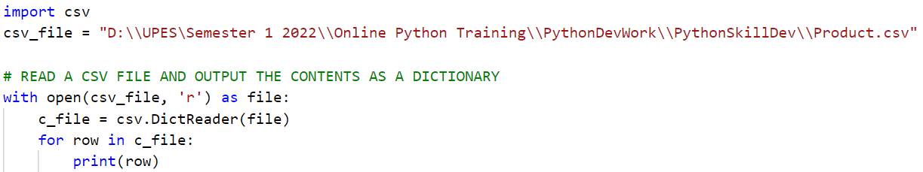
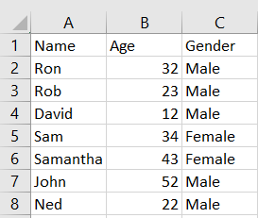
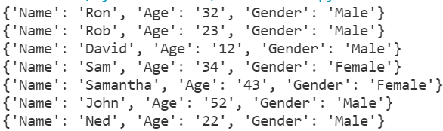
Working with CSV files:
The DictReader() method inputs a csv file and
Creates a python dictionary.
That is a Key-Value pair

Slide 9
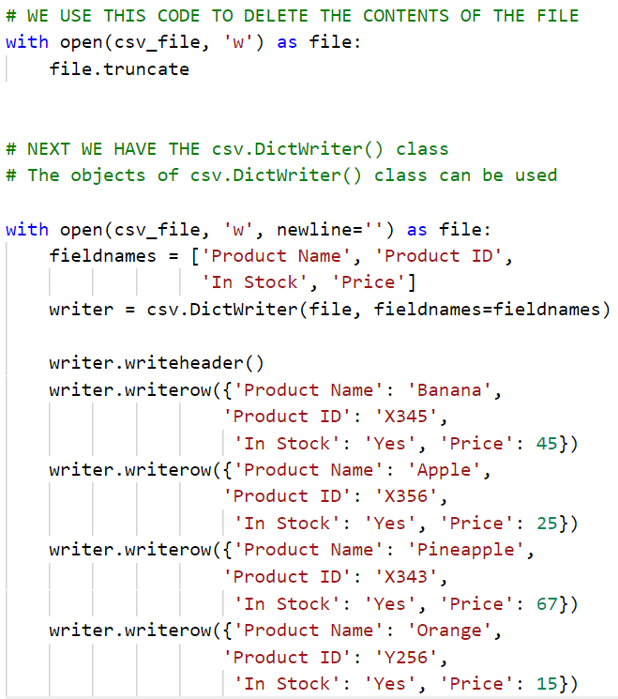
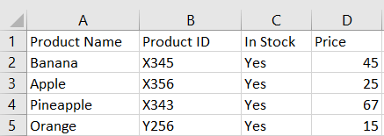
Working with CSV files:
We can use the truncate method to delete contents of the csv file
We also write to a csv file from a dictionary.
As shown in the code this can be done by using the DictWriter method.

Slide 10
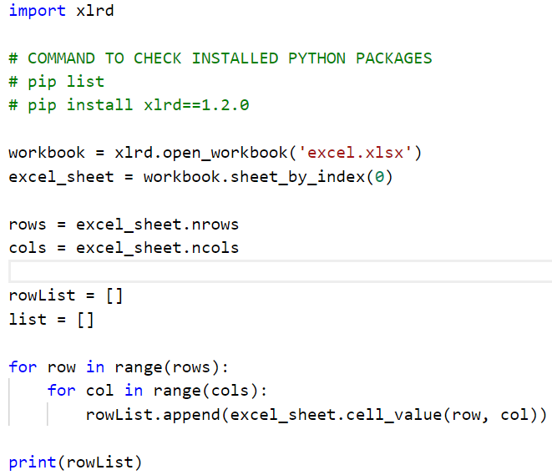
Working with EXCEL files:
We can use the import xlrd package to work with excel files.
We start reading content of an excel file by first opening it.
The method is open_workbook()
An excel file can have multiple sheets
We can use the sheet_by_index() method to read the first sheet.
The nrows and ncols can be used to fetch total number of rows and columns in an excel sheet.

Slide 11
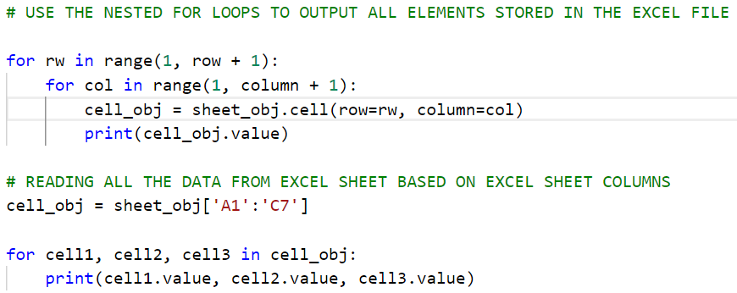
Working with EXCEL files:
The nested for loops are used to read contents of excel sheet.
We can also pass the sheet columns and instantiate an array as shown in the code.

Slide 12
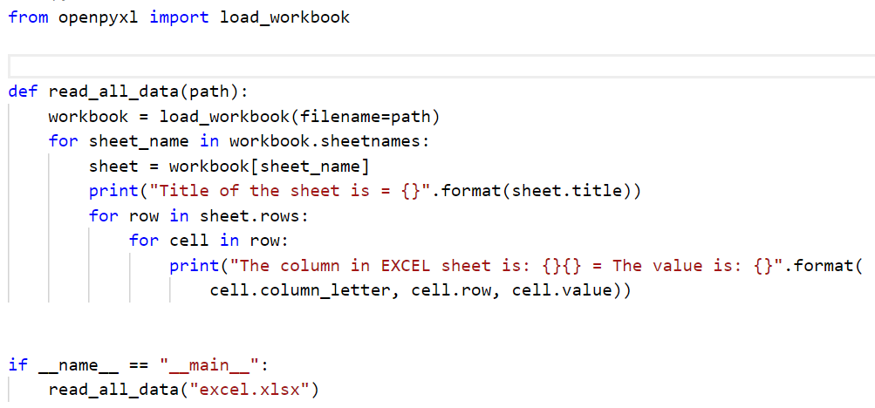
Working with EXCEL files:
Python also provides another powerful package openpyxl for working with excel data.
As shown in the code.

Slide 13
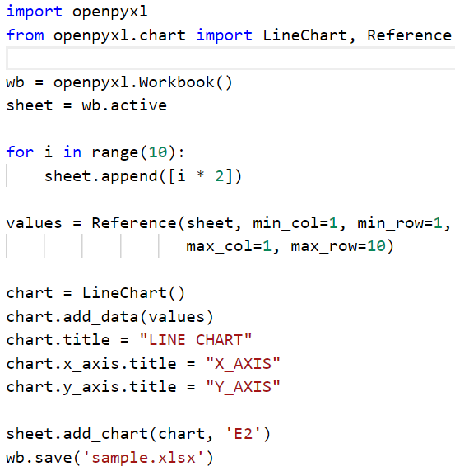
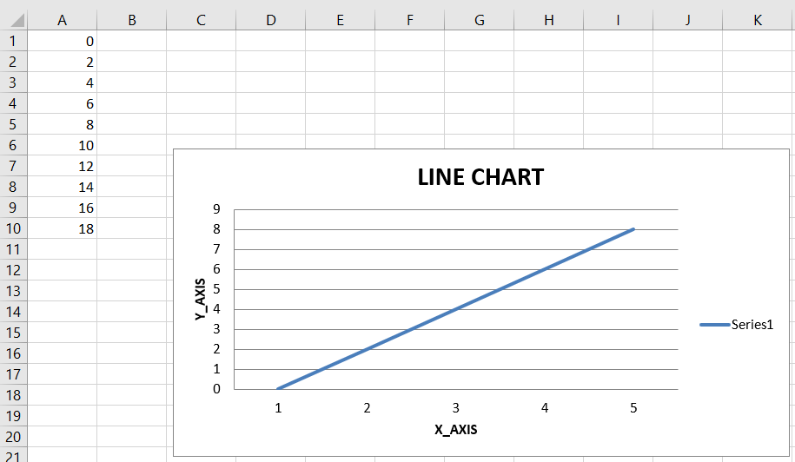
Working with EXCEL files:
The openpyxl package can also be used to create visualizations.

Slide 14
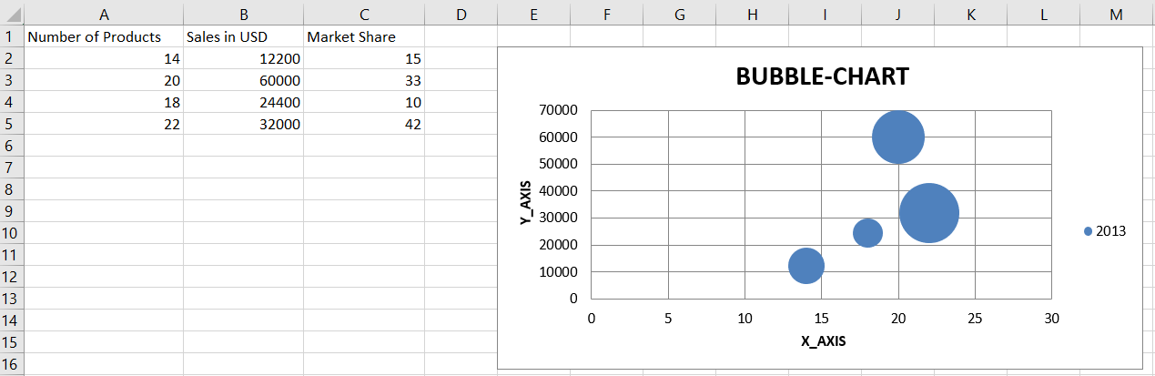
Working with EXCEL files:
With the help of openpyxl we can create many other charts in excel
Such as
Barcharts
Bubble charts
Line charts

Slide 15
Working with advanced python packages
Numpy, pandas, matplotlib, seabourn etc.

Slide 16
Numpy
NumPy is a Python library used for working with arrays.
It also has functions for working in domain of linear algebra, fourier transform, and matrices.
NumPy was created in 2005 by Travis Oliphant. It is an open source project and you can use it freely.
NumPy stands for Numerical Python.

Slide 17
Numpy and Matplotlib

Slide 18
Pandas and Seabourn

